Slide 1
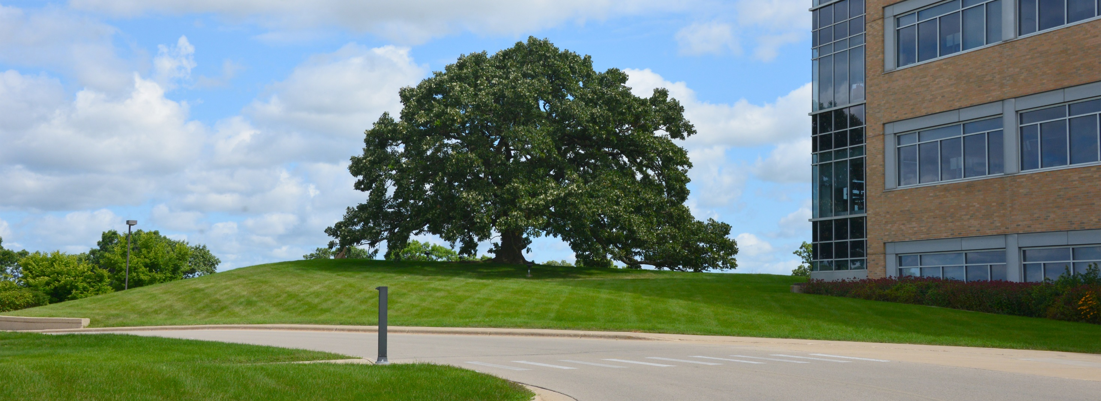

The WI Farm Center – Here When Farmers Need Us
Kevin Plante & Karen Endres
AgrAbility Summit: April 6, 2023
Notes:
Karen

Slide 2
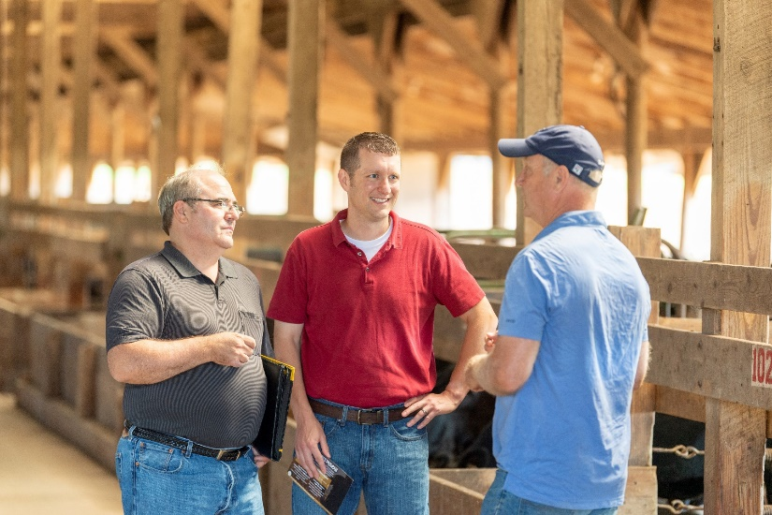
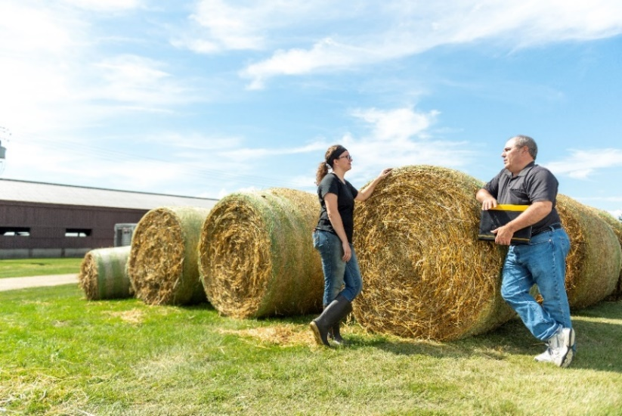
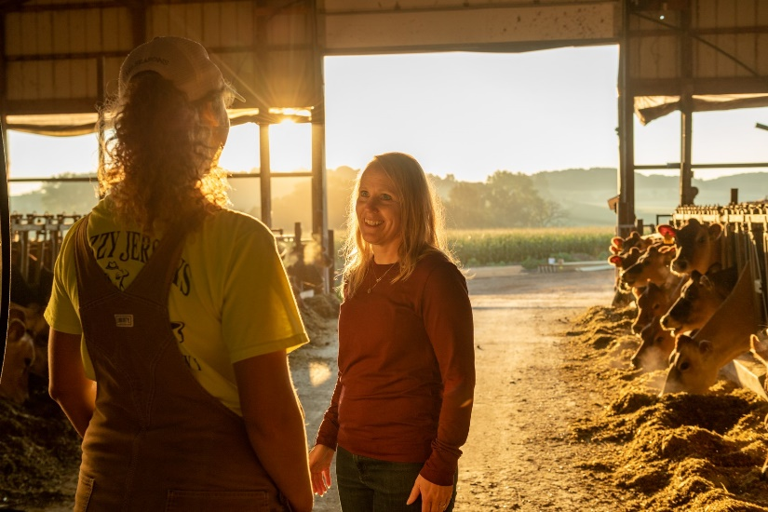
here when Farmers need us!
Notes:
Karen

Slide 3

Notes:
The WI Farm Center was born out of necessity following the financial crisis of the 1980’s which saw a farm recession saddle many Midwest farmers with heavy debt loads as tight money policies of the Federal Reserve caused farmland values to drop up to 60% in some parts of the Midwest.
In its infancy the Farm Center focused on building relationships with both Ag lenders and farmers in our state to increase the availability of farm loans to producers in order to help weather this crisis and remain in business.
Over time its services have evolved and expanded. All services are free and confidential for WI farmers and today the Farm Center team focuses on several key areas which we will detail in upcoming slides.
As seen on the slide the team monitors a toll-free Farm Center helpline 5 days a week, a group email address, and has its own website.
Some caller questions we can answer quickly, some we refer to other agencies, and others become ongoing cases we consult on.

Slide 4
Programs and services
Farmer Wellness
Conflict Mediation
Veteran Farmer Assistance
Succession & Transition Planning
Financial & Business Consulting
Herd-Based Diagnostics
Notes:
Kevin

Slide 5
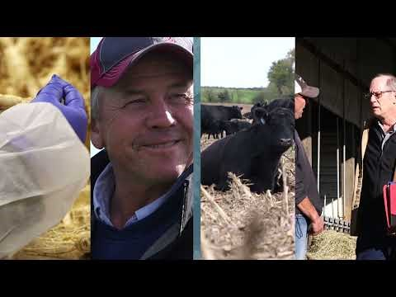
Farm center info video

Slide 6
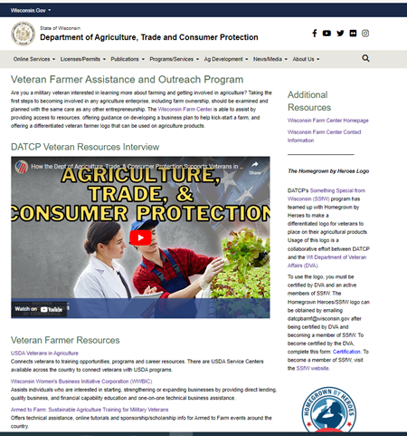
Veteran Farmer Assistance and Outreach
Dedicated program page as part of the Farm Center’s website
Source for general info on both state and federal veteran farmer resources
Notes:
Kevin

Slide 7

Veteran Farmer Assistance and Outreach
1:1 coaching for aspiring and/or operating veteran farmers
  Similar to the Farm Center’s Financial Consulting and Transition Planning service, but provides more in-depth and detailed financial analysis, including:
  Annual budgeting and cash flow projections
  Assistance with borrowing requests
  Guidance on developing business structures and ongoing recording keeping
  Help connecting with other farm business management resources
Notes:
Kevin

Slide 8

Veteran Farmer Assistance
and Outreach
Collaborate with Farmer Veteran Coalition and Wisconsin DVA on veteran farmer marketing logo
Also partner with state and federal agencies, non-profits, and other organizations on veteran farmer programming
Notes:
Kevin

Slide 9

Veteran programming partners
WI Farmer Veteran Coalition
Easterseals/AgrAbility of WI
WI Veteran Chamber of Commerce
WI Department of Veteran Affairs (DVA)
Women's Business Initiative Corp
VA Hospital – VA FARMS Pilot
Are there others we should be working with?
Notes:
Kevin

Slide 10

Veteran farmer programming priorities
Interacting with more veteran farmers to increase familiarity with the Farm Center and our services
Improve understanding of veteran farmer needs to build a pipeline of future programming ideas
How can we better help?
Notes:
Kevin

Slide 11

Notes:
Karen
Currently we are in the 2nd year of this exciting new pilot program
In the upcoming slides we will share some information with regard to the various services available to WI farmers as a part of this program, as well as information about other partnerships DATCP is a part of to help farmers manage and reduce stress and improve wellbeing

Slide 12
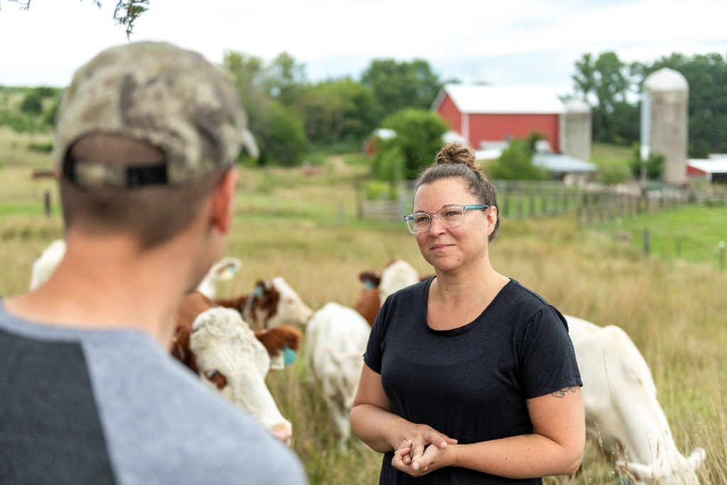
WI Farmer Wellness Program
Multiple options to reduce barriers & meet needs
Tele-Counseling
24/7 Farmer Wellness Helpline
Online Farmer Support Groups
Counseling Voucher Program
Notes:
Karen

Slide 13

Wellness Services to Meet Your Needs
Work with us to find an option that best fits your needs
Options available for all Wisconsin farmers & their families
  Strong network of counselors with knowledge of farming
  Specialists in a variety of topics including: substance use, anxiety, family relationships
Megan Wolf, Dual Diagnosis Counselor
Notes:
Karen

Slide 14

24/7 Farmer Wellness helpline
(888) 901-2558
In-the-moment counseling
Available 24/7/365
Staffed by team of experienced stress counselors
Free and confidential
Unlimited calls
Notes:
Karen

Slide 15
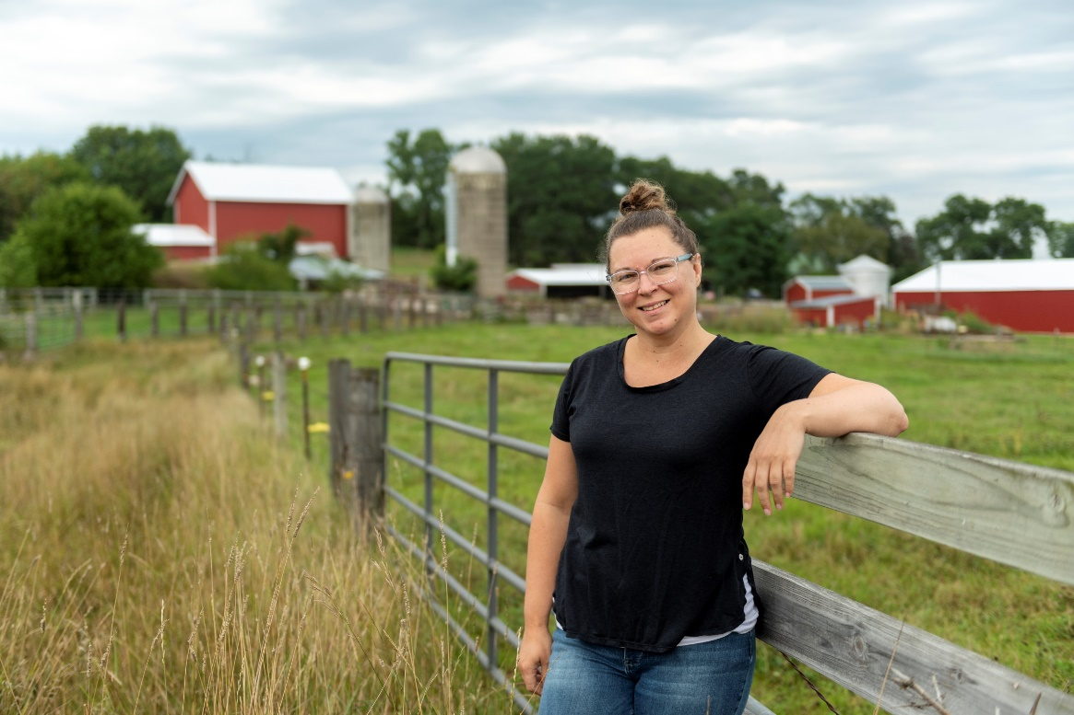
Tele-counseling
By Request
(800) 942-2474 or (888) 901-2558
Ongoing/scheduled counseling
Available via phone or web video
Licensed mental health professional familiar with rural WI and farming
Free and confidential
Unlimited sessions
Jes Beauchamp, Licensed Clinical Social Worker
Notes:
Karen—In collaboration with our mediation service, were recently working a farm case together and by combining our skill sets we have been able to make a LOT of progress with one of our farm families after getting stuck for many months. This is just another example of why it is so important to have complimentary programs and skill sets at the Farm Center.

Slide 16
Counseling voucher program
By Request
(800) 942-2474
Ongoing/scheduled in-person counseling
Covers cost of appointments
FY22 data (July ‘21 – June ‘22)
  159 vouchers redeemed; 2nd all-time high
  81% estimated voucher redemption rate; all-time high
Notes:
Karen

Slide 17

Online Farmer support groups
Held online via Zoom
Led by trained peer leaders with assistance from a licensed mental health professional
60 minutes per session
Participants can choose to be anonymous on screen
Notes:
Karen—Farm Center staff DOES NOT attend and are currently prohibited from doing so, so I have not seen a group session yet. However, the farmers who participate seem to really enjoy being able to talk through their situations and problems with other farmers who may have similar experiences. Just knowing that they aren’t alone and being able to bounce ideas off other farmers who aren’t necessarily right down the road from them has proven to be a really nice program for them.

Slide 18

Rural realities podcast
20 episodes in catalog and growing
Over 1,500 downloads to date
Popular episodes include:
  Breaking the Stigma on Mental Health
  Use a Positive Mindset & Gratitude to Handle Daily Farm Stress
  Discussing the "Undiscussabull”
*Available at https://farmcenter.wi.gov
and on most popular podcast platforms
Notes:
Karen

Slide 19

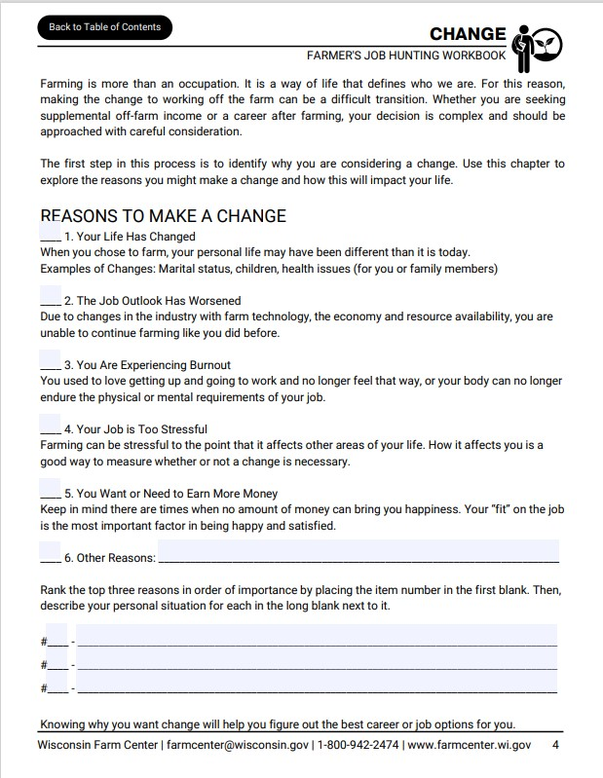
The Farmer’s Job Hunting Workbook
Self-paced workbook for farmers
  Setting goals
  Dealing with the stress of change
  Identifying transferable skills
  Resume & cover letter writing
  Interview skills
Notes:
Karen

Slide 20
Thank you!
Questions or Discussion?
Wisconsin Farm Center
(800) 942-2474 | farmcenter@wisconsin.gov
7:45 am to 4:30 pm Monday – Friday
24/7 WI Farmer Wellness Helpline – (888) 901-2558
Notes:
Dan
To begin to wrap up this presentation I wanted to give our Farm Center contact info and 24/7 WI Farmer Wellness Hotline number one more time.
The Farm Center 800 # is staffed from 7:45 to 4:30 – Monday - Friday
Information and assistance is available on, but not limited to, topics such as:
-Financial challenges & questions
-Natural disaster assistance
-Government programs for WI farmers
-Locating community resources
-Someone to talk to who shares a deep passion for agriculture & farming

Slide 21
Kevin Plante & Karen Endres
kevin.plante@wisconsin.gov; karenk.endres@wisconsin.gov
Kevin Cell: (608) 327-9814; Karen Cell: (608) 982-6007
Wisconsin Farm Center – Division of Agricultural Development
WISCONSIN DEPARTMENT OF AGRICULTURE, TRADE AND CONSUMER PROTECTION (DATCP)
Notes:
And then to officially conclude I wanted say “Thank You” for taking time today to listen on this important topic. I hope it introduced you to services available for the challenges all farmers face. A quote from one of our farm clients says it best, “There is HOPE…”

